Slide 1

Implementing the EU Sustainable Textiles Strategy
Dirk Vantyghem, 11 June 2024

Slide 2

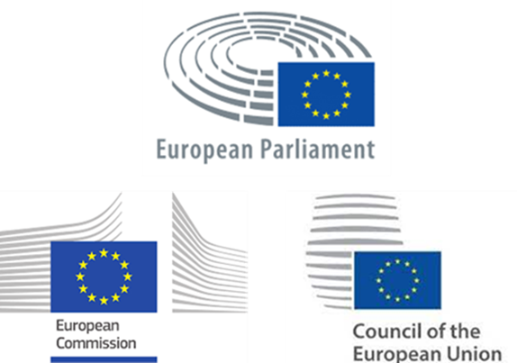

Slide 3





















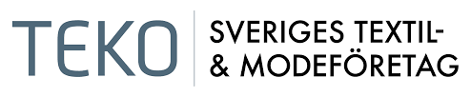








EURATEX Membership – 30 Full Members

Slide 4















EURATEX Membership – 10 Corresponding Members & 6 Partners

Slide 5
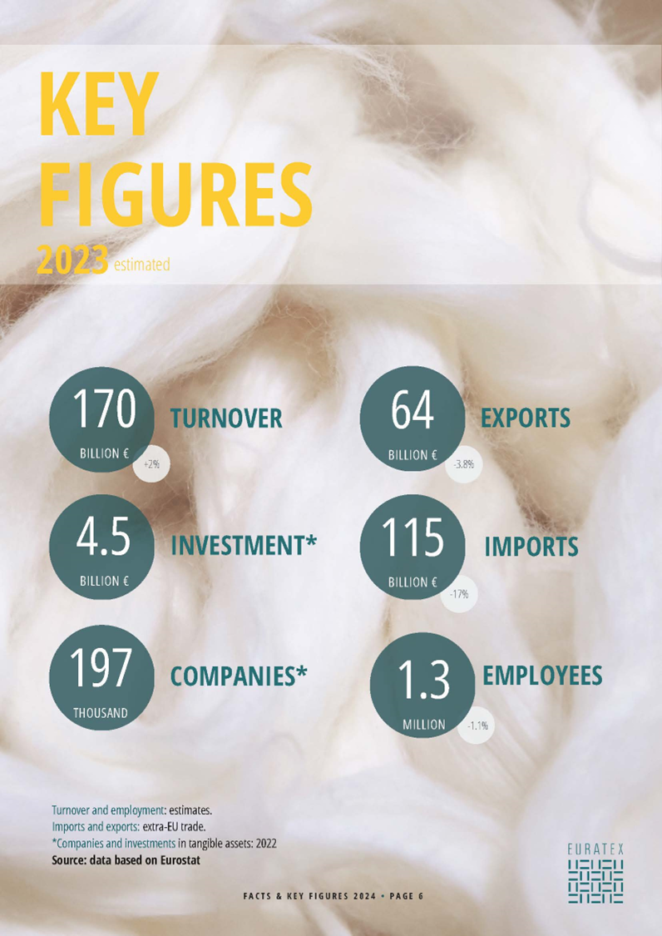

Slide 6
EU-27 Trade | Main export partners
“Switzerland and the United Kingdom are the EU27 main export markets”
64
billion EUR
T&C EU exports
Source:
EURATEX, based on IHS-Eurostat
Notes:
Source: Euratex Spring report 2022

Slide 7
EU-27 Trade | Main import partners
“1/3 of T&C products sold to EU markets are made in China”
115
billion EUR
T&C EU imports
Source:
EURATEX, based on IHS-Eurostat
Notes:
Source: Euratex Spring report 2022

Slide 9
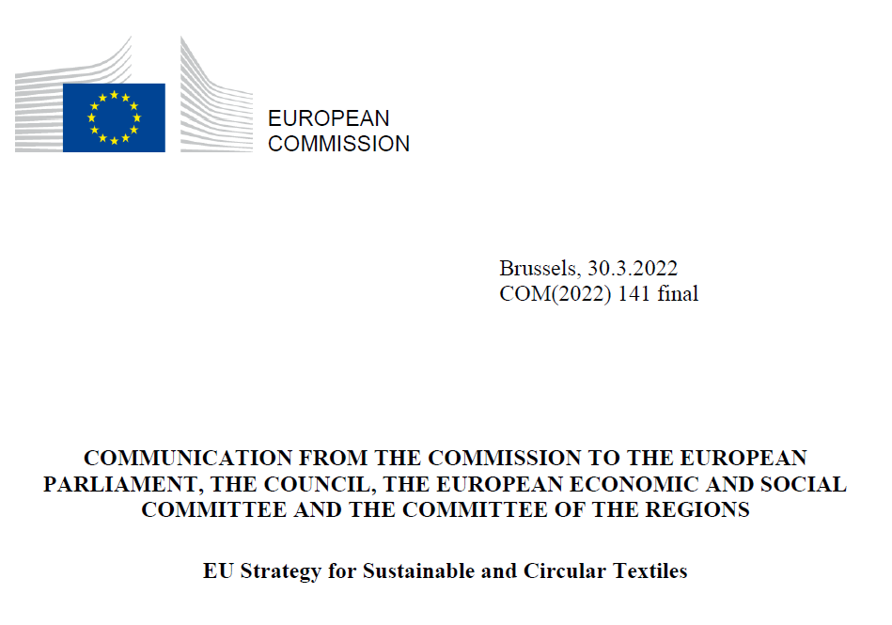


Slide 10
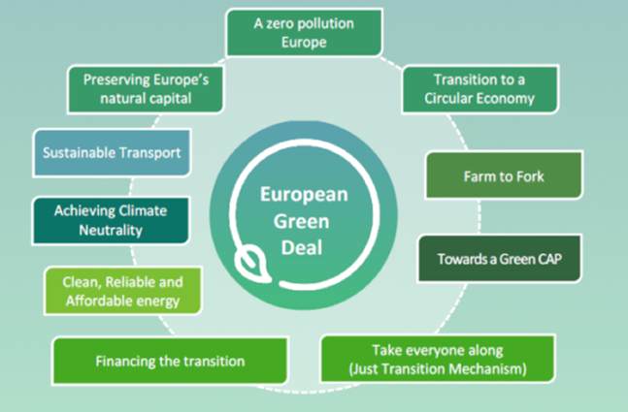



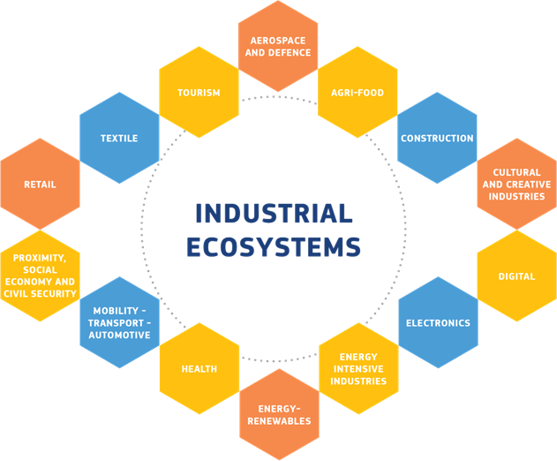
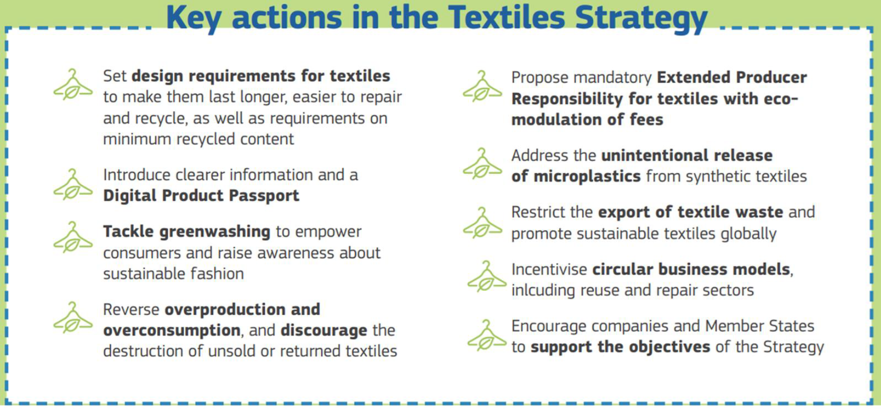

2020
2021
2022
2023-2024

Slide 11
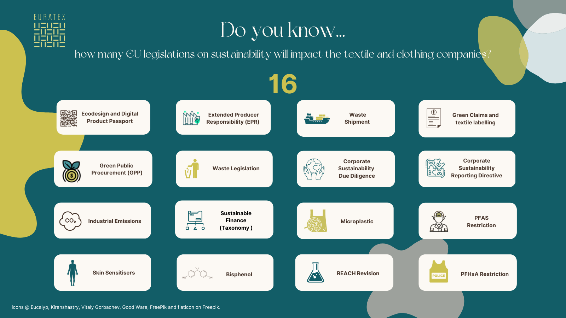

Slide 12
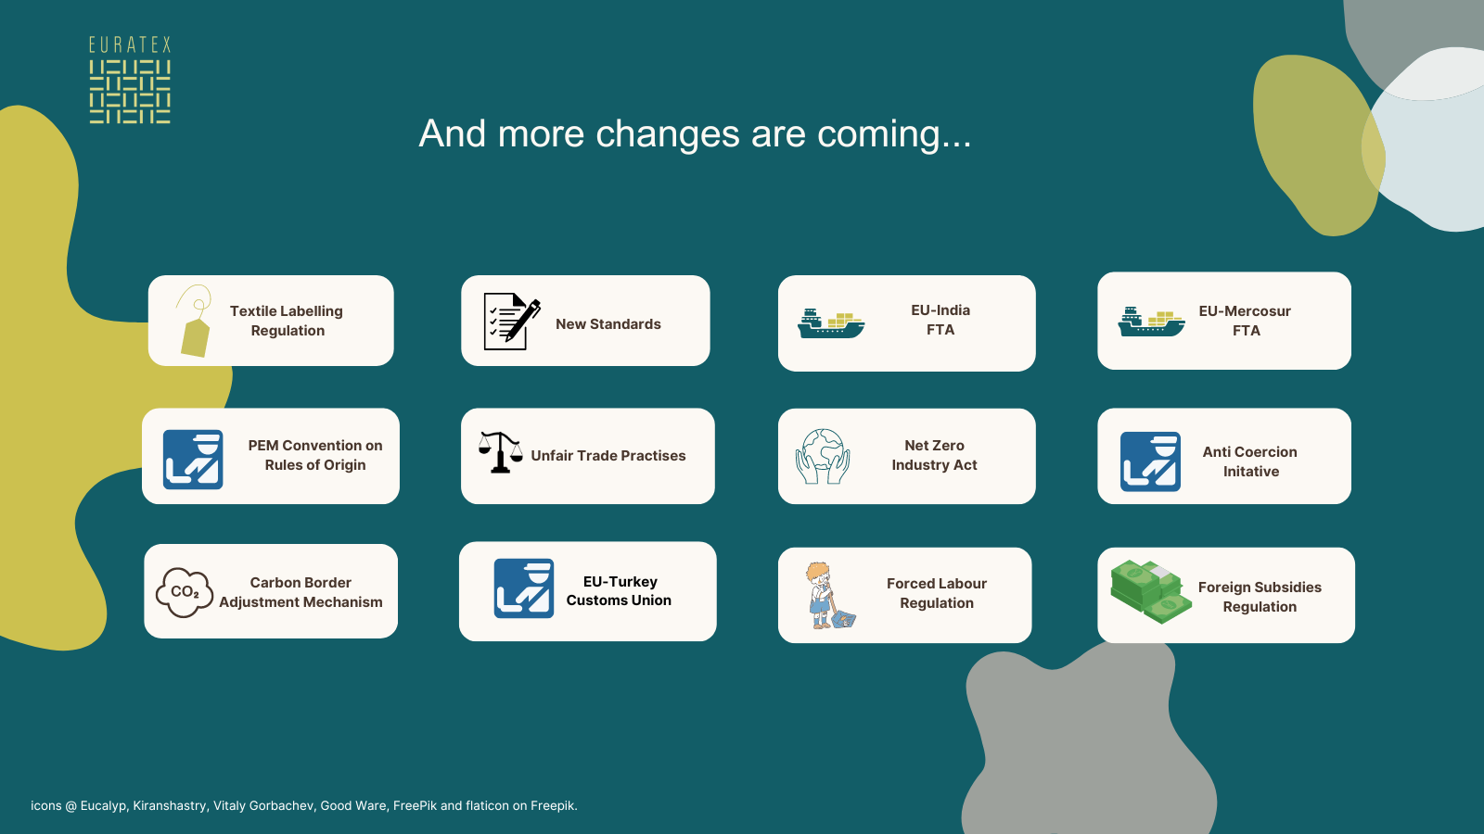

Slide 13
4 conditions to make it work…
1. Quality of the regulatory framework
2. EU Strategy has to become a Global Strategy…
Coherent
Enforceable
Predictable
To ensure level playing field
To make a significant impact on the planet
Measurable
To establish global standards and definitions
3. Stimulate more demand for sustainable fashion
Work on consumer behaviour
Increase transparency (avoid greenwashing)
Green public procurement
4. Support the industry transition
Innovation and digitalisation
Affordable energy
Skills
Capacity
SME friendly

Slide 14





Focus on implementation

Slide 15


Slide 16
June
704 MEPs
Political Groups
President of the EC
27 Commissioners
July onwards
2025-2030
Annual budget €180 bln
Political & economic priorities
Green Deal vs Industrial Deal
Migration
EU Enlargement
Defence Strategy
Single Market
…

Slide 17

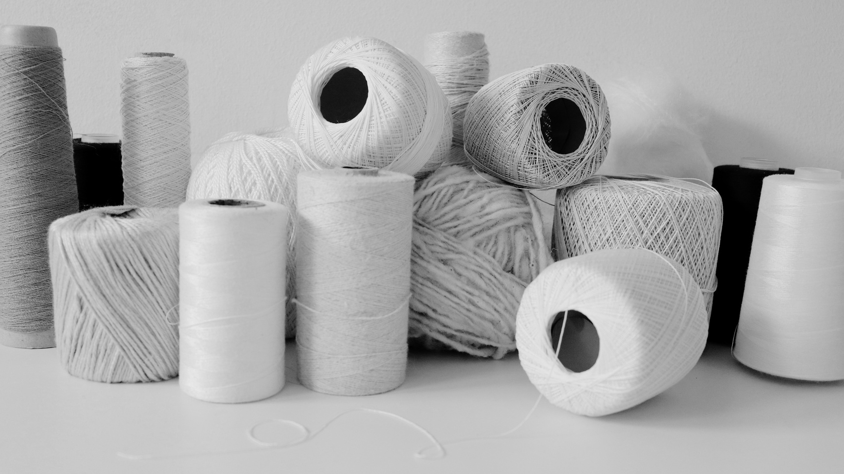
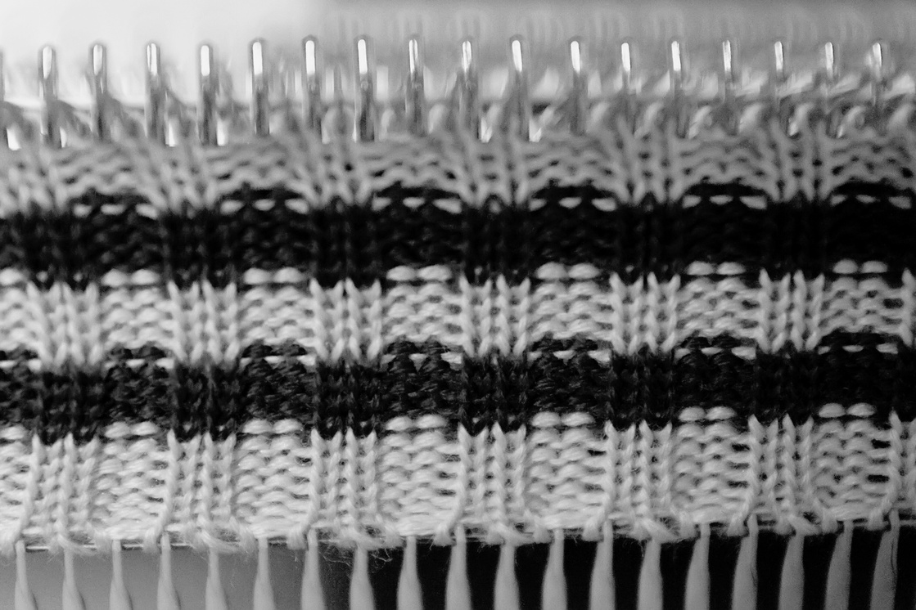

EURATEX Manifesto
Recommendations
from the European textiles
and apparel industry
for the European elections
of June 2024

Slide 18

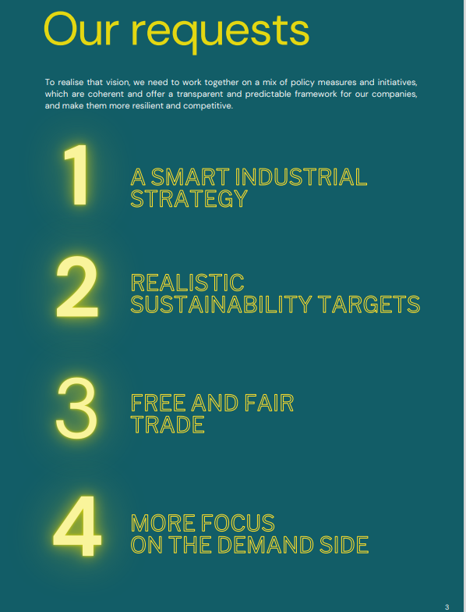

Slide 19

Thank You.
www.euratex.eu

